Slide 1
4-Link Robot Arm
Dallin Jacobs & Sebastian Zapata
ME 537

Slide 2
Project Overview
Objective: build and control a robotic manipulator
Main components:
3D printed parts
5 x MG996R Servos
Microcontroller - ESP32 dev board
11.1V LiPo battery (typical drone battery)
Voltage converter
Metrics for success
Implementation of mechanical and electrical design
Software control and forward kinematics
Inverse kinematics
Object avoidance

Slide 3
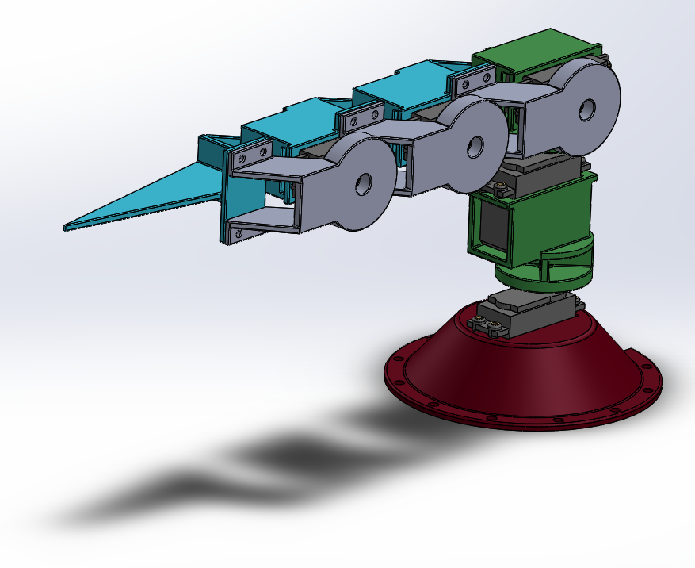
Mechanical Design
Standardized connectors so adding links is easy.
Strength capabilities were verified:
Torque=14 kg*cm
Very long arm (>50cm) is possible with servos
DH parameters were retrieved from CAD model and modeled as a 4-joint arm in ArmPlayer
First two links (trunk) are modeled as one joint, but split into 2 180-degree joints for control

Slide 4
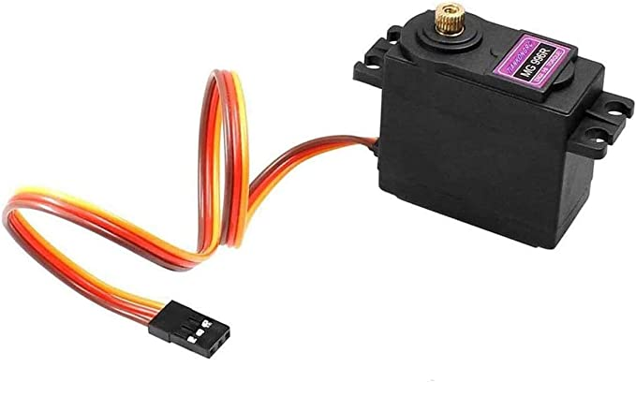
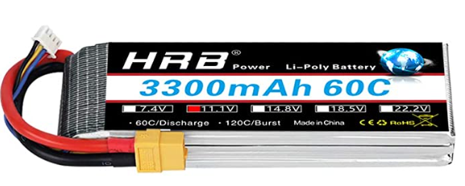
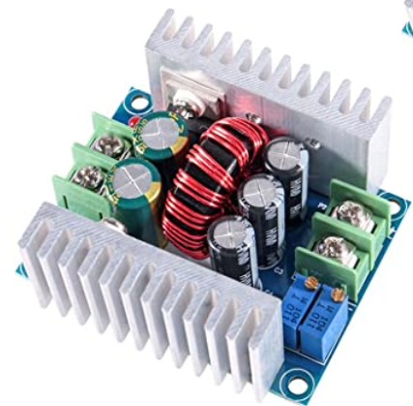
Electrical Design
Requirements:
Servos
4.8-6V operating voltage
2.2 A stall current x 5 servos = 11A peak current
Power Supply
LiPo Battery (regular drone)
Voltage output: 11.1 V - needs conversion
Current output: 180A (discharge), 360A (burst)
Voltage converter
Input: 6-40V
Output: 1.2-36V, 20A (enough for servos), 300W max

Slide 5
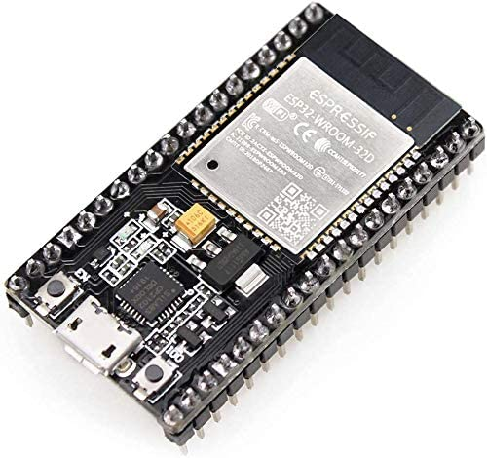
Software Design and Functionality Development
Software Design
ESP32 firmware (serial communication and servo signals)
Serial interface using Python: PC and ESP32
Modified libraries: SerialArm and ArmPlayer
Functionalities
Servo calibration of PWM signal
500-2500 us spec, 550-2350 experimentally more accurate for 0-180 degree range
Basic forward kinematics
Inverse Kinematics

Slide 6
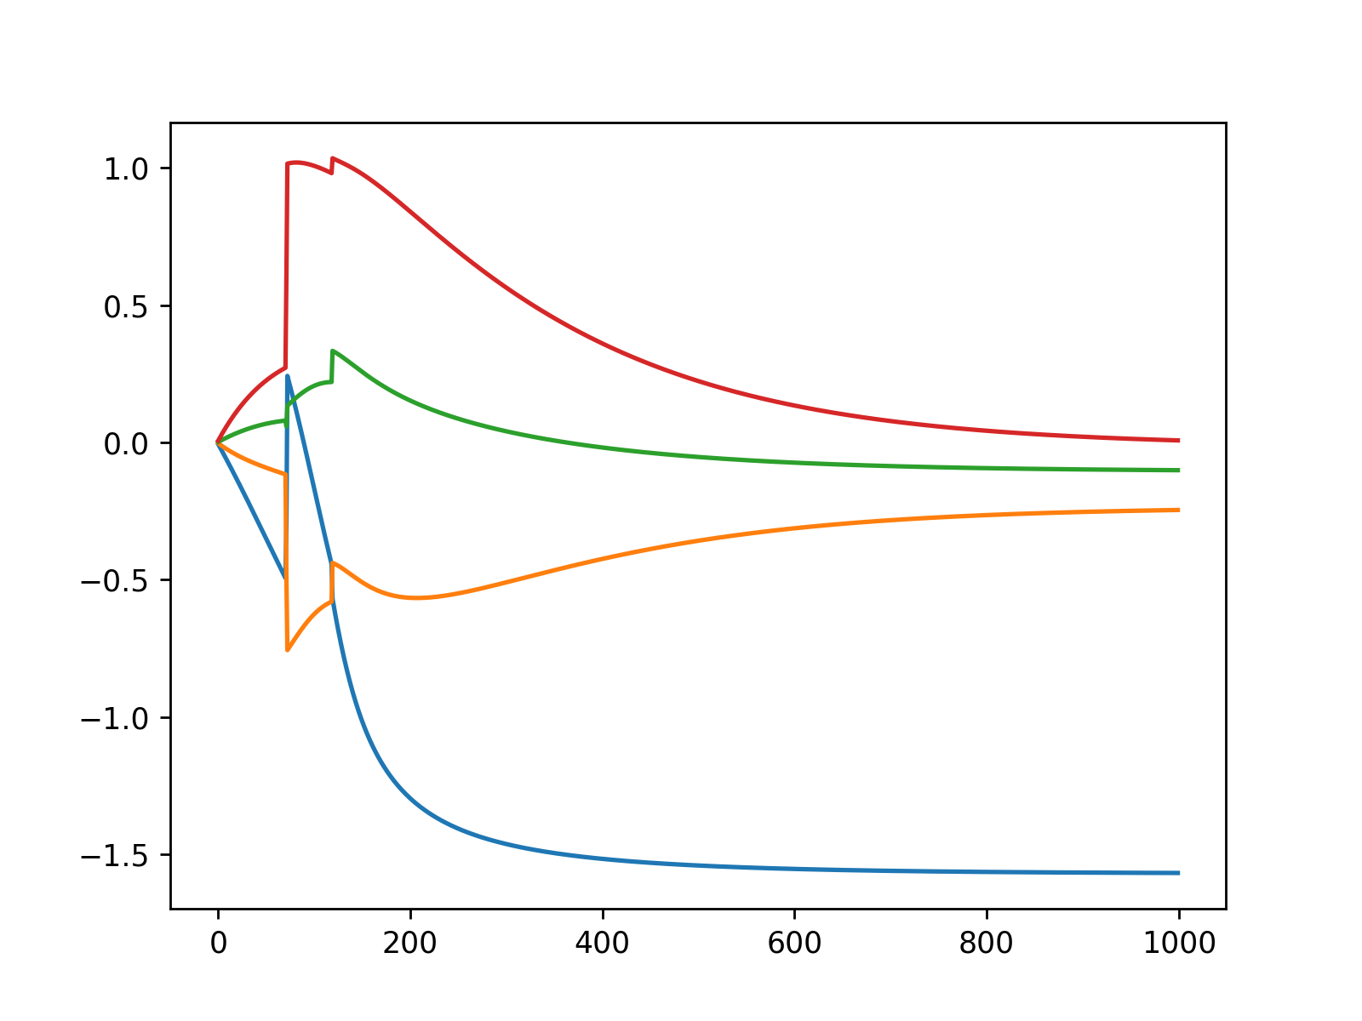
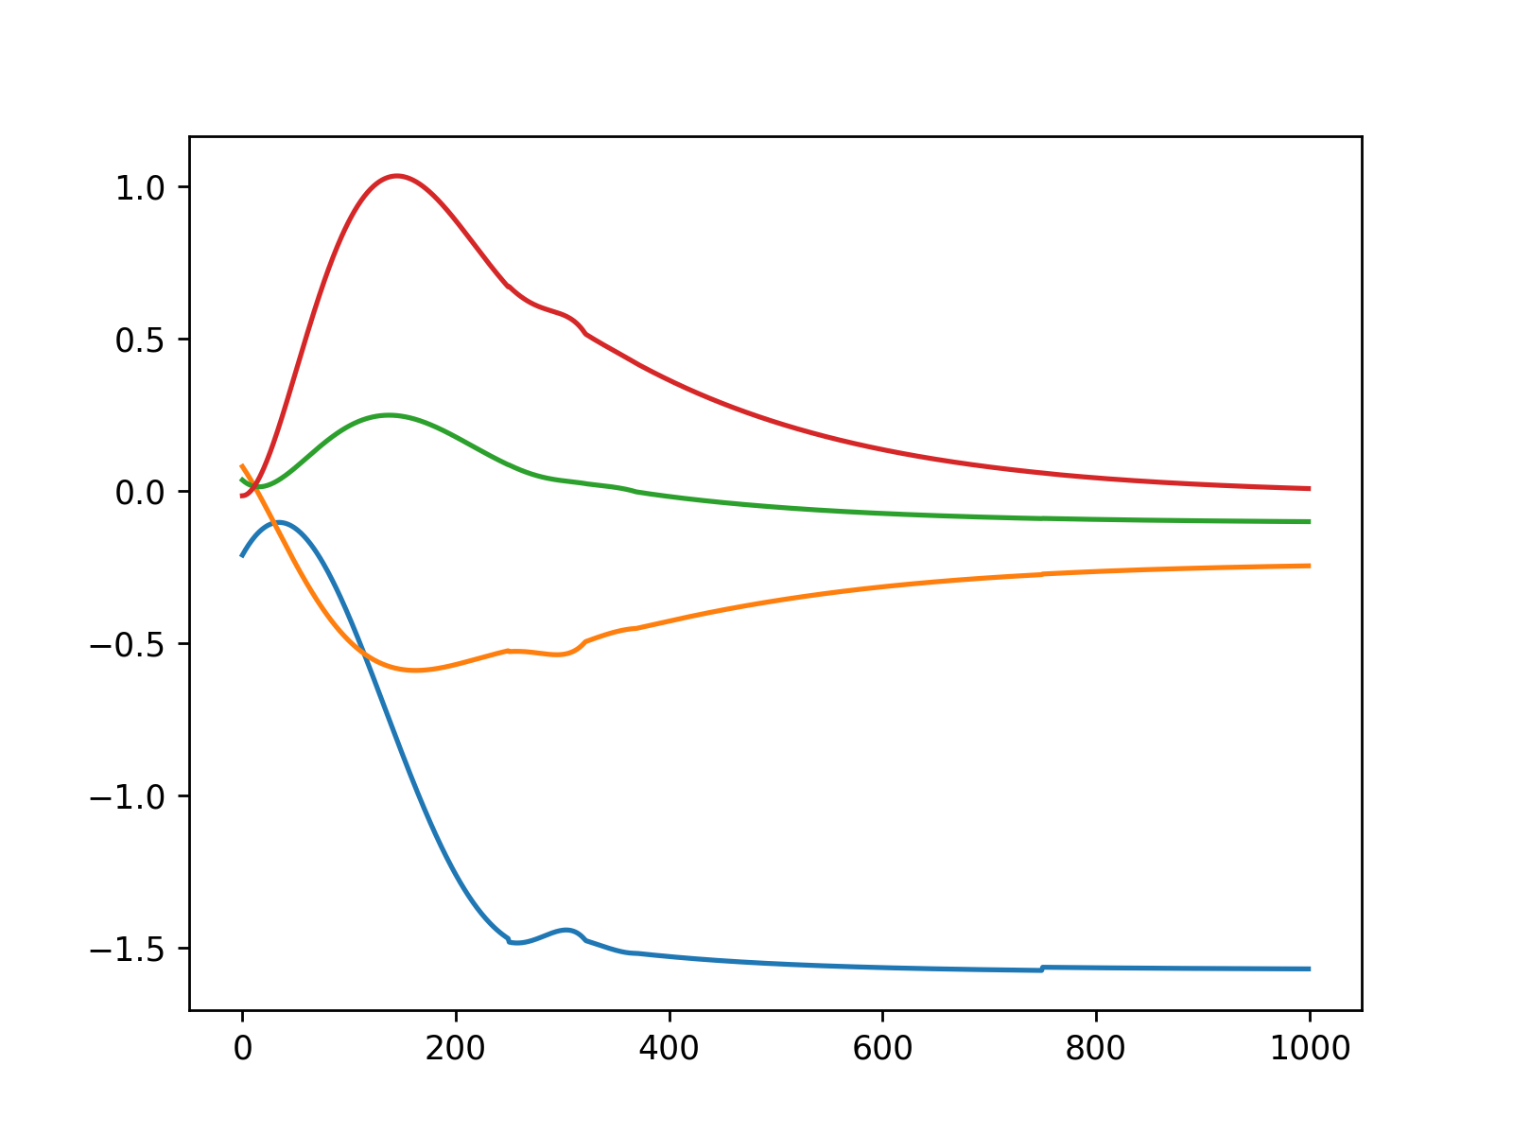
Object Avoidance
Original Joint Commands
Smoothed Joint Commands
Objective:
Reach target location with end effector
Avoid 1 object (sphere)
Avoid self
Additional limitations:
Joint limits
Floor limit
Method: Repulsive & Attractive Fields with limits
Post-processing: Savitzky-Golay Filtering
6th order polynomial
window_size = 501
Smooth out sequential joint commands for a more naturally moving robot
Angle (radians)
Angle (radians)
index
index

Slide 7
DEMO

